Slide 1

Project on National Data Portals in Samoa and Fiji Workshop 2 Experience Sharing and SDMX/.Stat Suite Tools 27-31 January 2025 Suva, Fiji
.Stat Suite: Power BI connector

Slide 2


Learning objectives
At the end of this session, you will be able to:
Connect Power-BI to an SDMX source

Slide 3
Outline
Installing
Connecting an SDMX source
Power BI resources

Slide 4
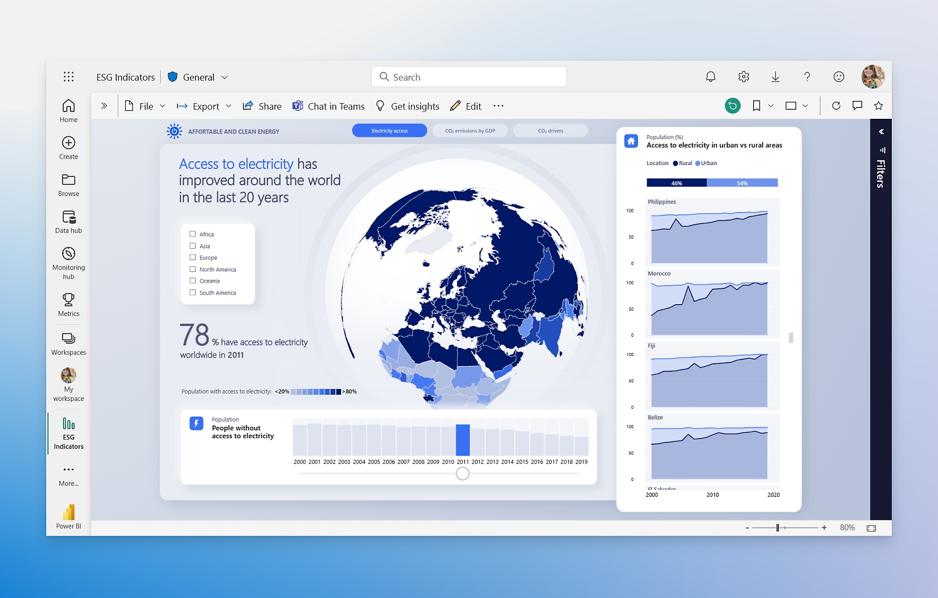
Power BI
Interactive data viz
Developed by Microsoft
Focus on Business Intelligence

Slide 5
Power BI
Extremely powerful
Mostly point-and-click
Desktop /Cloud versions
Dashboards can be embedded in other websites

Slide 6
Power BI
Install from:
https://aka.ms/pbidesktopstore

Slide 7
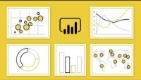
Power BI

Slide 8
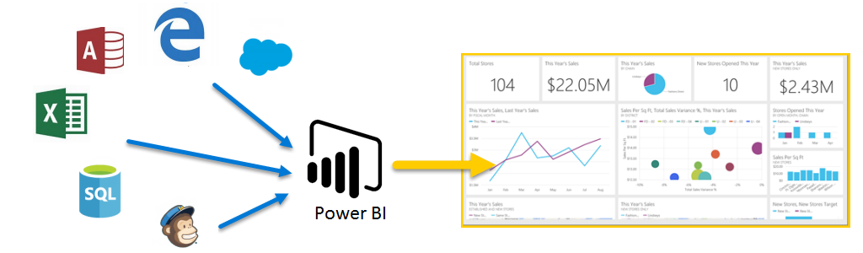
Power BI
Collection of :
Software services
Apps
Connectors
Work together to turn unrelated sources of data into interactive insights

Slide 9
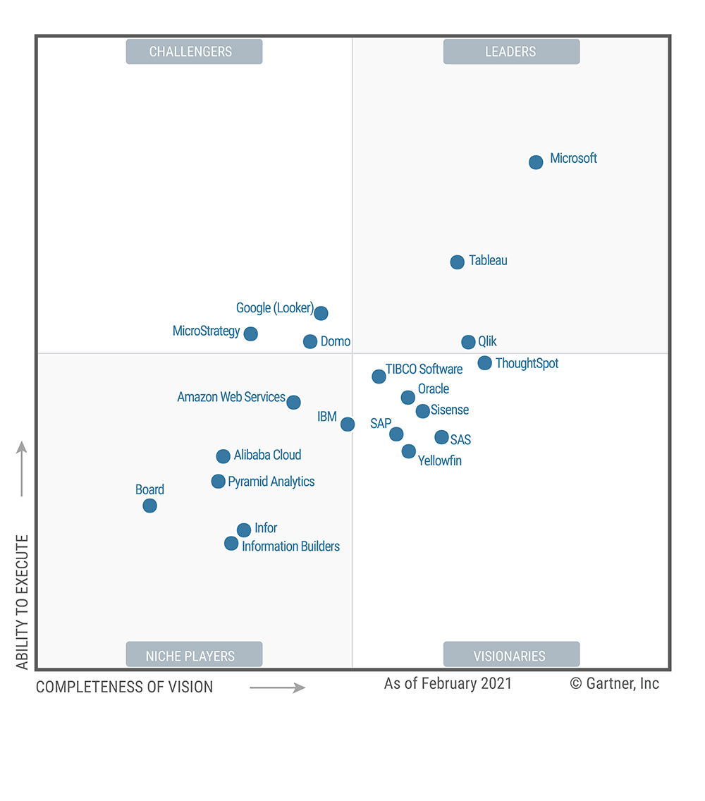



Power BI
Over 97% of Fortune 500 companies use Power BI (Source: Data Camp)
Over 6 million customers
A Microsoft solution made to be used by everyone
«Do more with less using an end-to-end BI platform to create a single source of truth, uncover more powerful insights, and translate them into impact.» (Source: Power BI).
2021

Slide 10


Slide 11
Installing the connector
Step by step
Copy the SDMX.mez file to the folder in [Documents folder]\Power BI Desktop\Custom connectors (create folder if needed).
Open Power BI Desktop.
Go to File menu.
Navigate to Options and Settings -> Options menu.
Select Security tab.
Under Data Extensions section, by default, “(Recommended) Only allow certified extensions to load” will be selected. Switch it to “(Not Recommended) Allow any extension to load without validation or warning”.
click on the OK button and restart Power BI.
In the Get Data connector list, just search for “SIS-CC”, or “SDMX”.

Slide 12
gitlab.com/sis-cc/sdmx-tools/sdmx-power-bi/
https://stats-sdmx-disseminate.pacificdata.org/rest/data/SPC,DF_TOURISM_EARNINGS,1.0/A.WS+FJ..USD?startPeriod=2010&dimensionAtObservation=AllDimensions

Slide 13
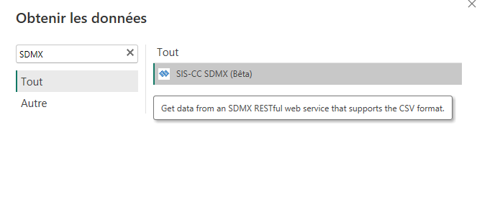
Connecting
Step by step
Open Power BI Desktop.
Open Get Data, and type “SDMX” in the search box.
In Data query URL write an SDMX REST query
Select a Display format.
(optional) In the Label language preference specify a language.
Click ok. Data will appear in the Preview screen.
The dataflow concepts will appear in the Fields pane to construct your report

Slide 14
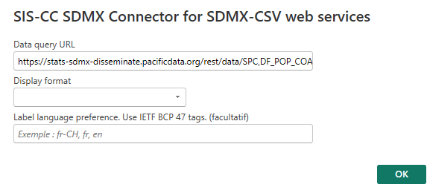
Connecting
Step by step
Open Power BI Desktop.
Open Get Data, and type “SDMX” in the search box.
In Data query URL write an SDMX REST query
Select a Display format.
(optional) In the Label language preference specify a language.
Click ok. Data will appear in the Preview screen.
The dataflow concepts will appear in the Fields pane to construct your report

Slide 15
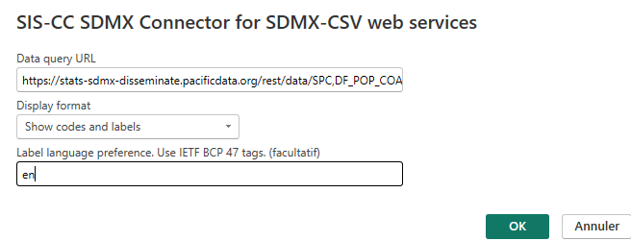
Connecting
Step by step
Open Power BI Desktop.
Open Get Data, and type “SDMX” in the search box.
In Data query URL write an SDMX REST query
Select a Display format.
(optional) In the Label language preference specify a language.
Click ok. Data will appear in the Preview screen.
The dataflow concepts will appear in the Fields pane to construct your report

Slide 16
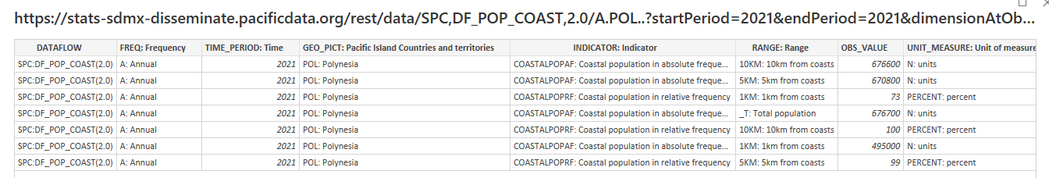
Connecting
Step by step
Open Power BI Desktop.
Open Get Data, and type “SDMX” in the search box.
In Data query URL write an SDMX REST query
Select a Display format.
(optional) In the Label language preference specify a language.
Click ok. Data will appear in the Preview screen.
The dataflow concepts will appear in the Fields pane to construct your report

Slide 17
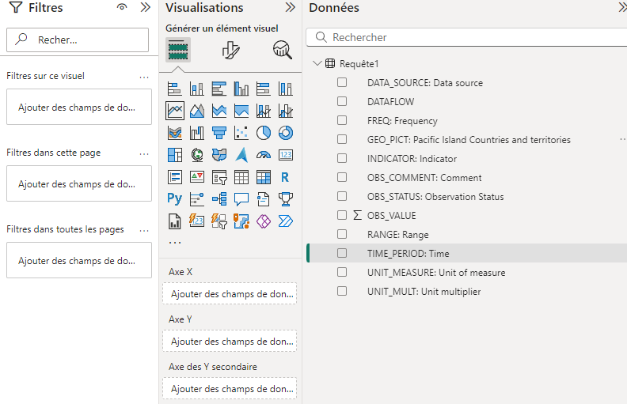
Connecting
Step by step
Open Power BI Desktop.
Open Get Data, and type “SDMX” in the search box.
In Data query URL write an SDMX REST query
Select a Display format.
(optional) In the Label language preference specify a language.
Click ok. Data will appear in the Preview screen.
The dataflow concepts will appear in the Fields pane to construct your report

Slide 18
Further Resources
Learning Power-BI is a long journey, with many discoveries along the way. Some resources to get deeper into it:
Official MS resources, with badges: https://aka.ms/pbilearn
Guy in a cube videos: https://www.youtube.com/@GuyInACube
And many more (google it!)

Slide 19
Discussion and Q&A

